Slide 1
Data Base System Week 8th Topics
Normalizations
Purpose & Characteristics of Normalized Database
Normal Forms (1NF, 2NF, 3NF, BCNF, 4NF & 5NF)
Example

Slide 2
Data Base System Week 8th Topics
Normalization
The process of producing a simpler and more reliable database structure
It is a technique used to keep data in such a way to remove redundancy, inconsistency and other anomalies of data i.e. to handle all drawbacks
Purpose of Normalization
Makes DB design efficient in performance i.e. Quicker updates and Easier to add data
To reduce the amount of data if possible
Less storage space
Makes DB design free of anomalies
Less data inconsistency
Makes DB design according to the rules of relational DB i.e. Flexible Structure
Identifies relationships between entities i.e. Clearer data relationships

Slide 3
Data Base System Week 8th Topics
Characteristics of Normalized Database
Each relation must have a key field
All fields must contain atomic data and with no repeating groups
Each table must contain info about a single entity
Each field must depend on a key field
All non key fields must be mutually independent
Note: Normalization is based on the analysis of functional dependency

Slide 4
Data Base System Week 8th Topics
Update Anomalies
Relations that contain redundant information may potentially suffer from update anomalies.
Anomaly: Errors or inconsistency that may result when a user attempt to update a relation that contains redundant data.
Types of update anomalies include:
Insertion,
Deletion,
Modification
Functional Dependency
Describes relationship between attributes in a relation. It means that is the value of one attribute is known, it is possible to obtain the value of another attribute. For example
Student (Regno#, sname, class)
If the value of regno# is known, it is possible to obtain the value of sname. It means the value of sname is FD on regno#. i.e. “Regno# determines sname”

Slide 5
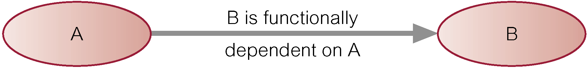
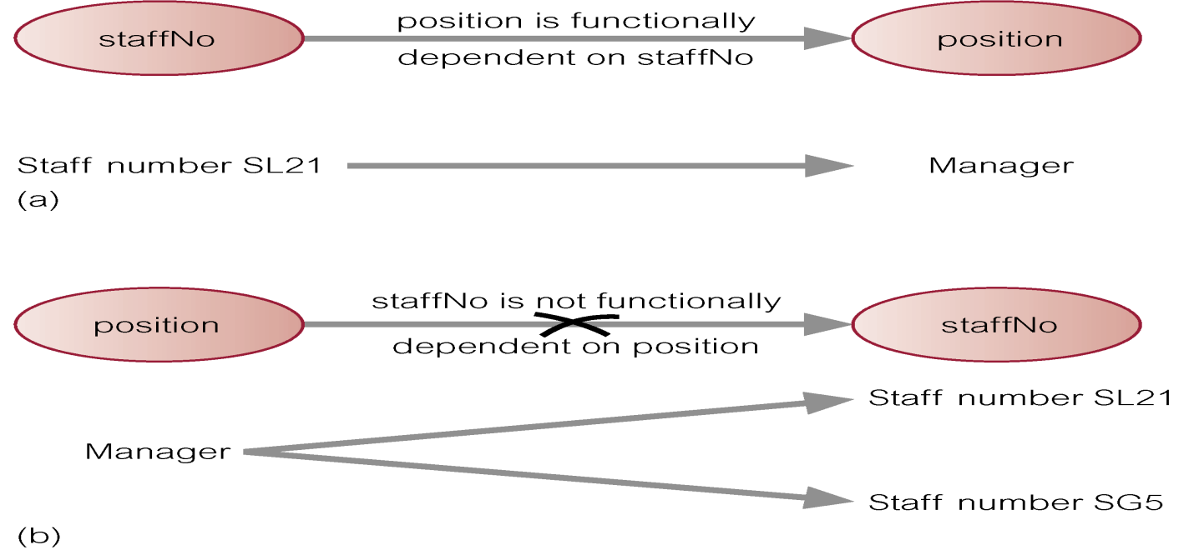
Data Base System Week 8th Topics
Diagrammatic representation:
Determinant of a functional dependency refers to attribute or group of attributes on left-hand side of the arrow.

Slide 6
Data Base System Week 8th Topics
The Process of Normalization
Formal technique for analyzing a relation based on its primary key and functional dependencies between its attributes.
Often executed as a series of steps. Each step corresponds to a specific normal form, which has known properties.
As normalization proceeds, relations become progressively more restricted (stronger) in format and also less vulnerable to update anomalies
Normal Form
A state of a relation that results from applying simple rules regarding functional Dependency
User View
Requirement specification and other data is collected and expressed in some structure format
Unnormalized Form (UNF) / Zero NF (0 NF)
transform data from information source (e.g. form) into table format with columns and rows i.e. tabular form. A table that contains one or more repeating groups.

Slide 7
Data Base System Week 8th Topics
Problems UNF
1. Repeating Groups / attributes
2. Multi Valued cells / attributes
3. No PK
4. Anomalies
5. Composite attributes
Example:
The above table is in 0NF having multi valued attribute EMP_NO, EMP_NM
Also it has EMP_NM as composite attribute
It has no PK and not according to the Relational Data Model
DPT_NO | MG_NO | EMP_NO | EMP_NM
D101 | 12345 | 20000 20001 20002 | Carl Sagan Mag James Larry Bird
D102 | 13456 | 30000 30001 | Jim Carter Paul Simon

Slide 8
Data Base System Week 8th Topics
First NF (1 NF)
A relation is said to be 1NF if it has no repeating groups and value in the cell will be atomic.
How?
Nominate an attribute or group of attributes to act as the Primary key for the unnormalized table.
Identify repeating group(s) in unnormalized table which repeats for the key attribute(s).
Split the tables
Create PK and FK
Check anomalies
Example:
Employee Table Employee_Detail Table
all attribute values are atomic because there are no repeating group and no composite attributes as well as have PK (EMP_NO) and FK (DPT_NO, MG_NO, EMP_NO).
EMP_NO | EMP_First | EMP_Last
20000 | Carl | Sagan
20001 | Mag | James
20002 | Larry | Bird
30000 | Jim | Carter
30001 | Paul | Simon
DPT_NO | MG_NO | EMP_NO
D101 | 12345 | 20000
D101 | 12345 | 20001
D101 | 12345 | 20002
D102 | 13456 | 30000
D102 | 13456 | 30001

Slide 9
Data Base System Week 8th Topics
4. Second NF (2 NF)
A relation that is in 1NF and every non-primary-key attribute is fully functionally dependent on the primary key
Based on concept of full functional dependency:
A and B are attributes of a relation, B is fully dependent on A if B is functionally dependent on A but not on any proper subset of A.
Problems
Partial Dependency: A FD in which one or more non-key attributes are FD on part of PK
Example:
There are two non-key fields (Cost, Supplier Address) . So, here are the questions:
Example is next slide..
Inventory
Description | Supplier | Cost | Supplier Address

Slide 10
Data Base System Week 8th Topics
If I know just Description, can I find out Cost? No, because we have more than one supplier for the same product.
If I know just Supplier, and I find out Cost? No, because I need to know what the Item is as well.
Therefore, Cost is fully, functionally dependent upon the ENTIRE PK (Description-Supplier) for its existence.
Inventory
Description | Supplier | Cost

Slide 11
CONTINUED…
Data Base System Week 8th Topics
Inventory
Description | Supplier | Cost | Supplier Address
If I know just Description, can I find out Supplier Address? No,
because we have more than one supplier for the same product.
If I know just Supplier, and I find out Supplier Address? Yes.
The Address does not depend upon the description of the item.
Therefore, Supplier Address is NOT functionally dependent upon the
ENTIRE PK (Description-Supplier) for its existence.
Supplier
Name | Supplier Address

Slide 12
So putting things together
Data Base System Week 8th Topics
Inventory
Description | Supplier | Cost | Supplier Address
Inventory
Description | Supplier | Cost
Supplier
Name | Supplier Address
The above relations are now in 2NF since the relation has no non-key attributes which has FD on part of PK i.e. Fully FD on PK

Slide 13
Data Base System Week 8th Topics
5. Third NF (3NF)
A relation that is in 1NF and 2NF and in which no non-primary-key attribute is transitively dependent on any candidate key
Remove columns that are not dependent upon the primary key
Problem
Transitive Dependency (TD)
TD is a condition in which an attribute is dependent on an attribute that is not part of the PK
Example:
Non-de Plume: a writer uses a name instead of his or her real name means a pen name
Books
BookName | Author's Name | Author's Non-de Plume | No of Pages

Slide 14
Example of 3NF
Data Base System Week 8th Topics
If I know No of Pages, can I find out Author's Name? No. Can I find out Author's Non-de Plume? No.
If I know Author's Name, can I find out No of Pages? No. Can I find out Author's Non-de Plume? YES.
Therefore, Author's Non-de Plume is functionally dependent upon Author's Name, not the PK for its existence. It has to go.
Books
BookName | Author's Name | No of Pages
Author
BookName | Non-de Plume

Slide 15
Data Base System Week 8th Topics
Boyce-Codd Normal Form ( BCNF )
A relation is in BCNF if and only if every determinant is a candidate key
Every relation in BCNF is also in 3NF. However, relation in 3NF may not be in BCNF.
The difference between 3NF and BCNF is that
for a functional dependency A → B, 3NF allows this dependency in a relation if B is a primary-key attribute and A is not a candidate key,
whereas BCNF insists that for this dependency to remain in a relation, A must be a candidate key.

Slide 16
Data Base System Week 8th Topics
ClientInterview
ClientNo | interviewDate | interviewTime | staffNo | roomNo
CR76 | 13-May-02 | 10.30 | SG5 | G101
CR76 | 13-May-02 | 12.00 | SG5 | G101
CR74 | 13-May-02 | 12.00 | SG37 | G102
CR56 | 1-Jul-02 | 10.30 | SG5 | G102
FD1 clientNo, interviewDate → interviewTime, staffNo, roomNo (Primary Key)
FD2 staffNo, interviewDate, interviewTime→ clientNo (Candidate key)
FD3 roomNo, interviewDate, interviewTime → clientNo, staffNo (Candidate key)
FD4 staffNo, interviewDate → roomNo (not a candidate key)
As a consequece the ClientInterview relation may suffer from update anomalies.
For example, two tuples have to be updated if the roomNo need be changed for staffNo SG5 on the 13-May-02.

Slide 17
Example of BCNF(2)
Data Base System Week 8th Topics
To transform the ClientInterview relation to BCNF, we must remove the violating functional dependency by creating two new relations called Interview and StaffRoom as shown below,
Interview (clientNo, interviewDate, interviewTime, staffNo)
StaffRoom(staffNo, interviewDate, roomNo)
Interview
ClientNo | interviewDate | interviewTime | staffNo
CR76 | 13-May-02 | 10.30 | SG5
CR76 | 13-May-02 | 12.00 | SG5
CR74 | 13-May-02 | 12.00 | SG37
CR56 | 1-Jul-02 | 10.30 | SG5
StaffRoom
staffNo | interviewDate | roomNo
SG5 | 13-May-02 | G101
SG37 | 13-May-02 | G102
SG5 | 1-Jul-02 | G102
BCNF Interview and StaffRoom relations

Slide 18
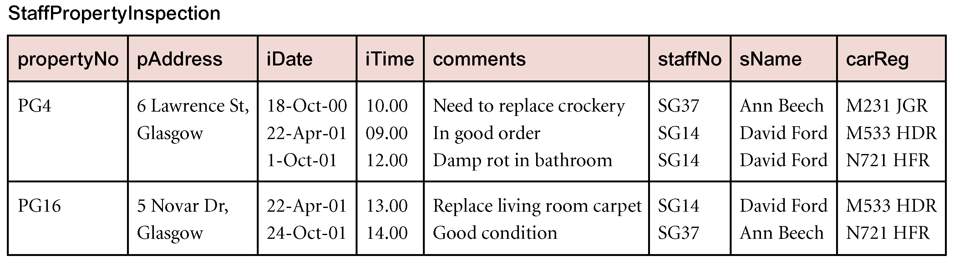
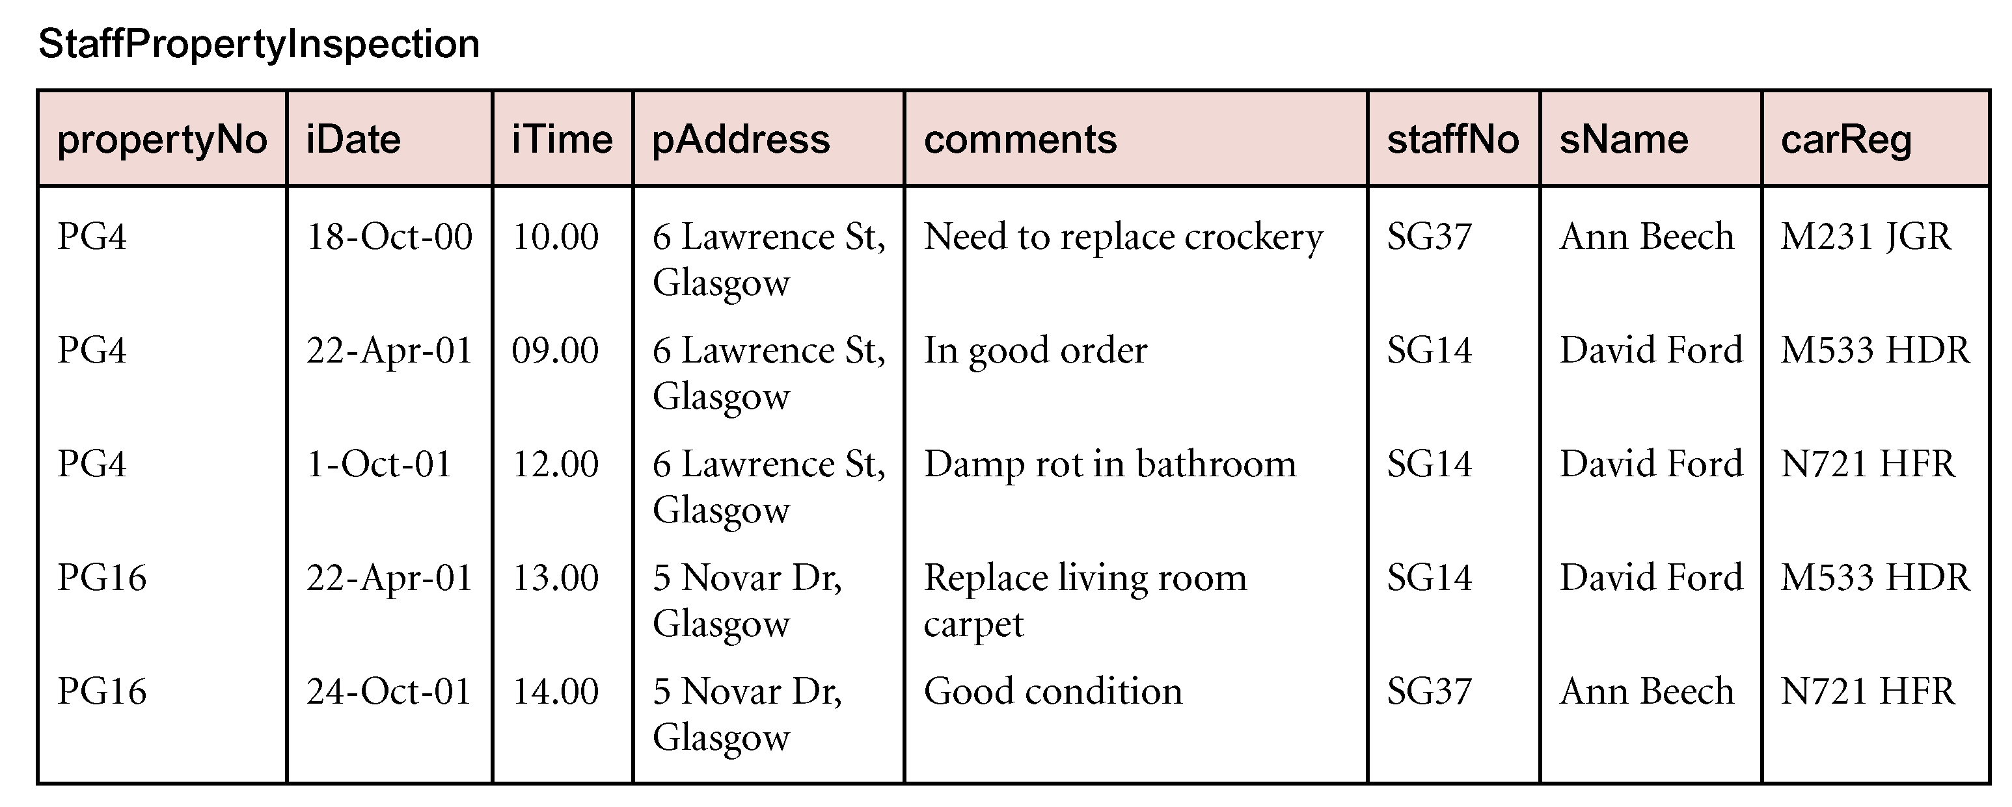
Data Base System Week 8th Topics
Review of Normalization (UNF to BCNF)

Slide 19
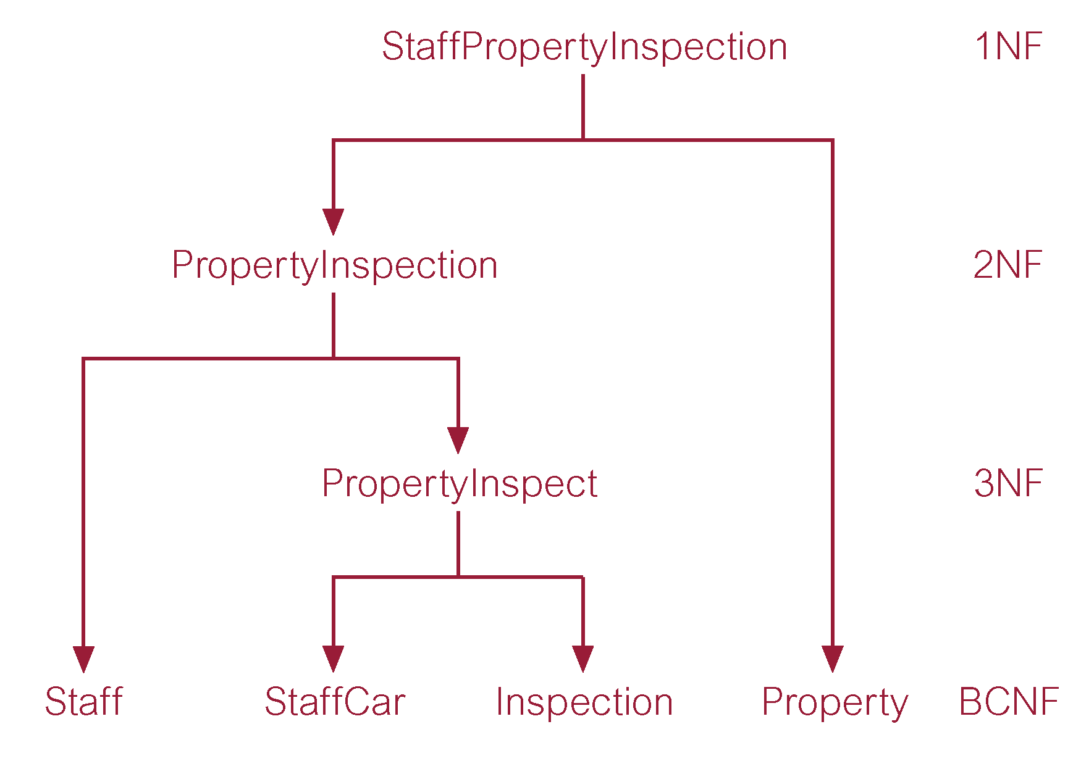
Data Base System Week 8th Topics
Review of Normalization (UNF to BCNF)

Slide 20
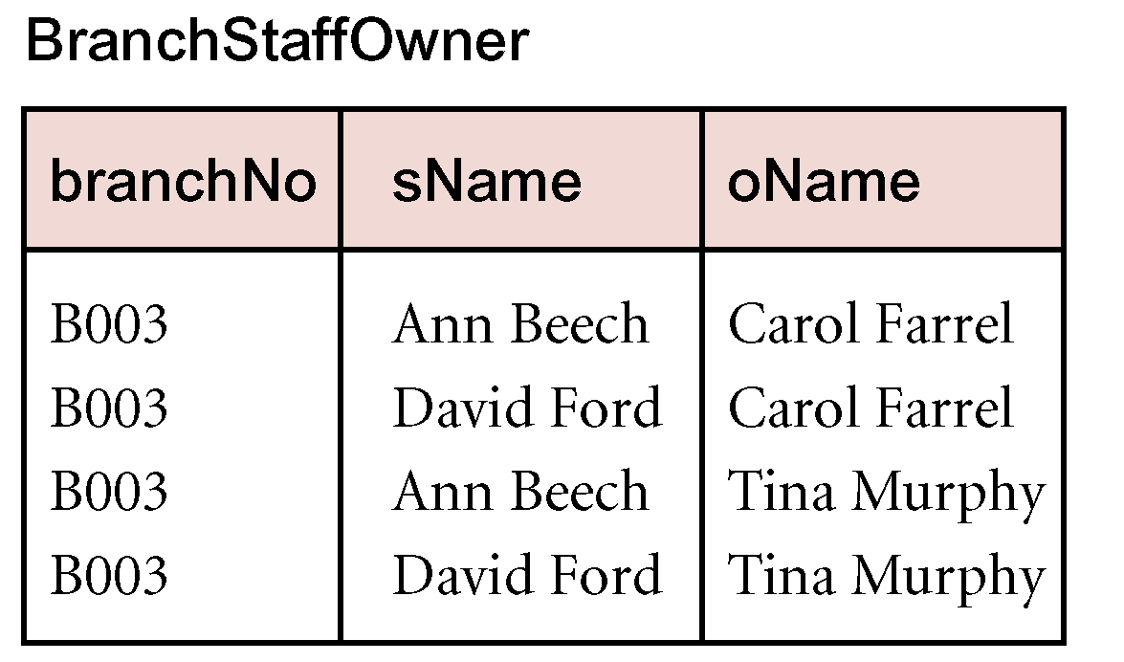
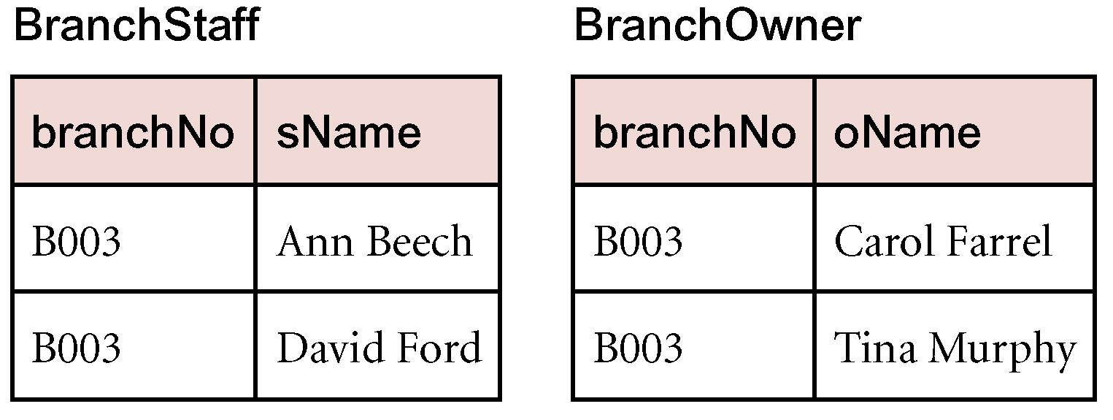
Data Base System Week 8th Topics
Fourth Normal Form (4NF)
Although BCNF removes anomalies due to functional dependencies, another type of dependency called a multi-valued dependency (MVD) can also cause data redundancy.
Possible existence of MVDs in a relation is due to 1NF and can result in data redundancy.
Dependency between attributes (for example, A, B, and C) in a relation, such that for each value of A there is a set of values for B and a set of values for C. However, set of values for B and C are independent of each other.
MVD between attributes A, B, and C in a relation using the following notation:
A ⎯⎯ØØ B
A ⎯⎯ØØ C

Slide 21
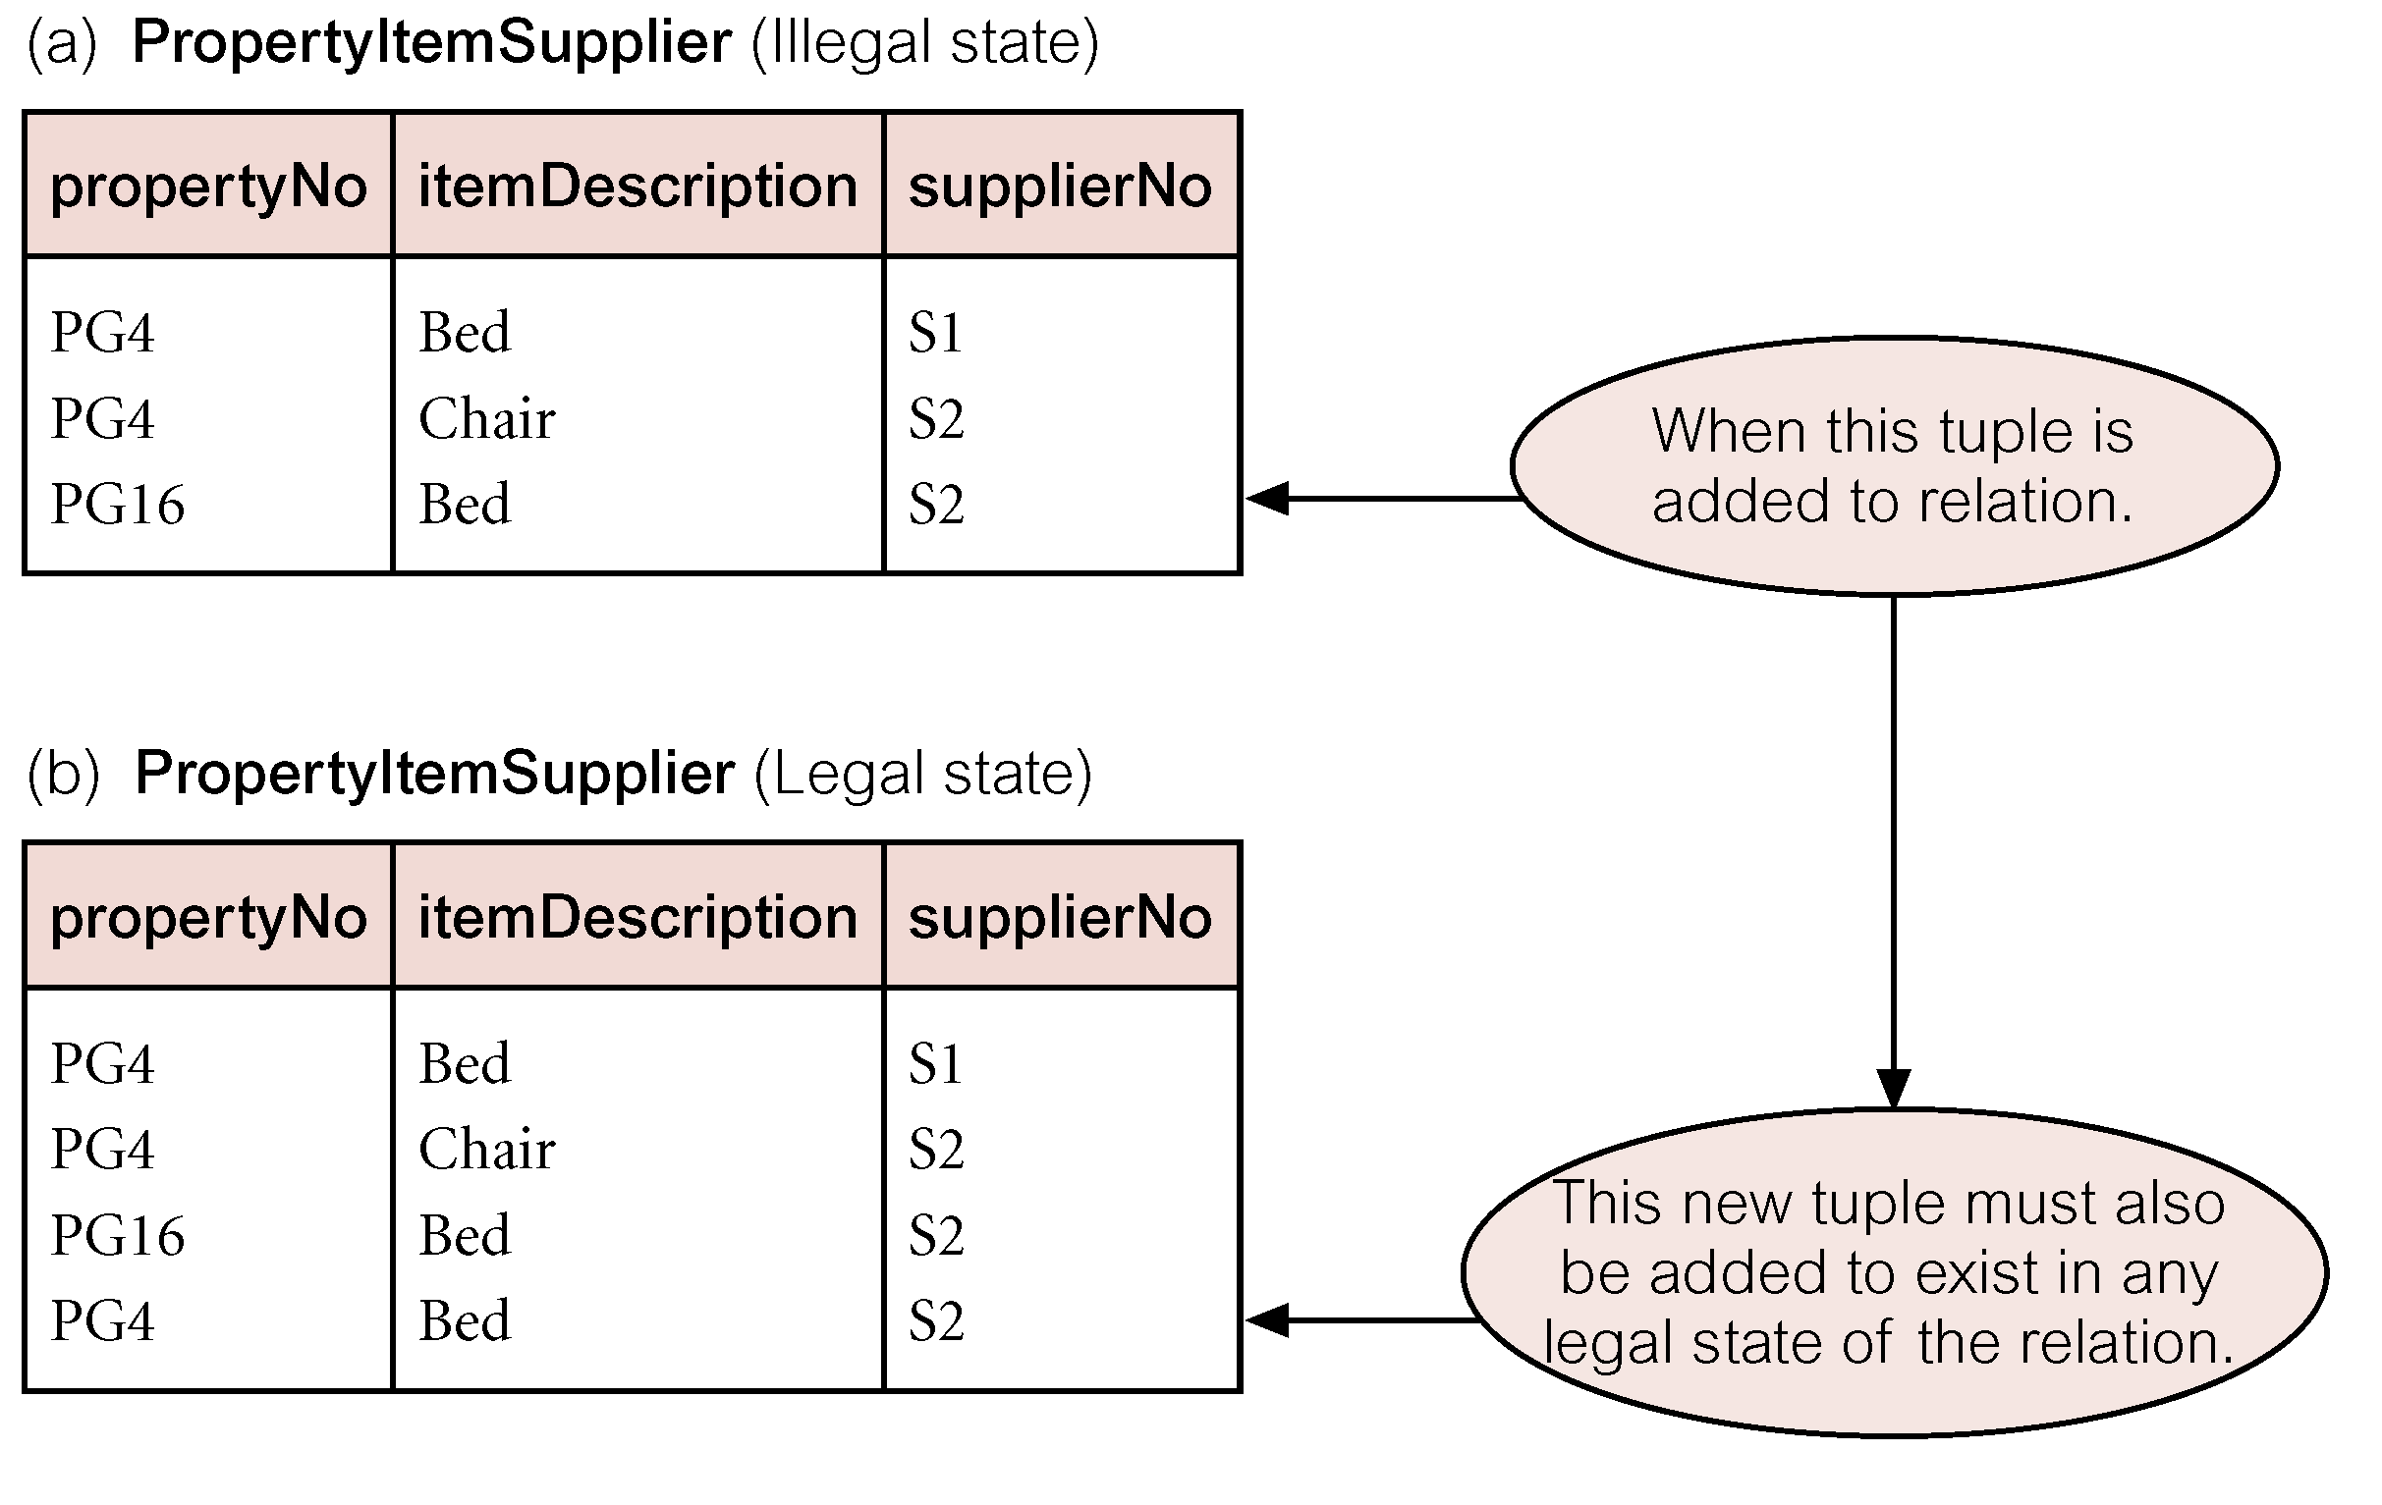
Data Base System Week 8th Topics
Fifth Normal Form (5NF)
A relation decomposed into two relations must have lossless-join property, which ensures that no spurious tuples are generated when relations are reunited through a natural join.
However, there are requirements to decompose a relation into more than two relations.
Although rare, these cases are managed by join dependency and fifth normal form (5NF).
A relation that has no join dependency.

Slide 22
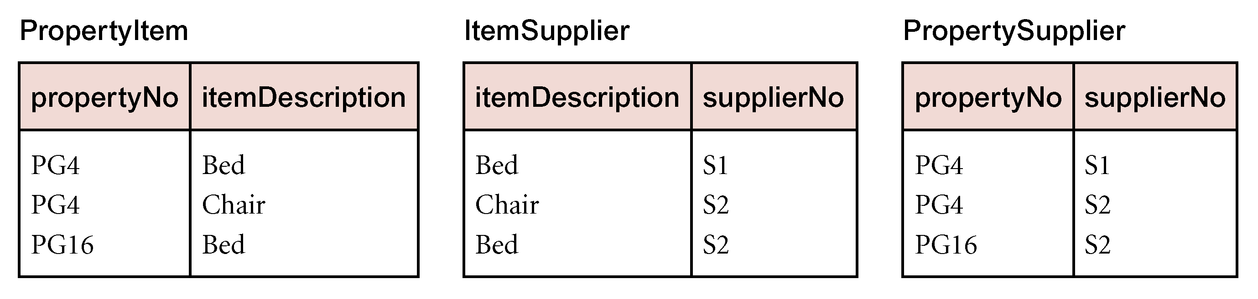
Data Base System Week 8th Topics
Fifth Normal Form (5NF)

